Slide 1

Best Seller Supplement Classification
This presentation outlines a classification AI project aimed at predicting whether a supplement will become a "Best Seller." By leveraging various data features and robust machine learning techniques, we aim to provide actionable insights for marketing and product strategy decisions. This practical evaluation will cover the methodology, results, and future potential of our classification model.

Slide 2

Introduction: Predicting Best Sellers
Project Goal
This project utilizes advanced classification techniques to predict whether a supplement will achieve 'Best Seller' status within a defined market segment. This binary classification (Yes/No) is crucial for strategic business decisions.
Key Features
The model incorporates a diverse set of features including product rating, total number of reviews, pricing tiers, specific product categories, and critical nutritional factors. These attributes are vital for accurately distinguishing high-potential products.
Strategic Objective
Our primary objective is to empower marketing and product development teams by identifying supplements with inherent best-seller potential. This proactive insight can significantly optimize resource allocation and enhance market positioning.

Slide 3





Essential Libraries & Tools
Data Handling
Visualization
ML Ecosystem
Pandas and NumPy were indispensable for efficient data loading, comprehensive manipulation, and various preprocessing tasks. They provided the foundational capabilities for structured data operations.
Matplotlib and Seaborn were employed for generating insightful data visualizations, including distributions, correlations, and model evaluation plots, which aided in understanding data patterns.
Scikit-learn served as the core framework for essential machine learning tasks, encompassing preprocessing pipelines, robust train-test splitting, diverse classification models, and comprehensive evaluation metrics.
Scaling Techniques
MinMaxScaler was specifically utilized to normalize features into a consistent 0-1 range, ensuring that no single feature disproportionately influences the model during training. We also explored other classifiers for robustness.

Slide 4





Comprehensive Preprocessing Steps
Missing Values
Missing numerical values were imputed using the mean of their respective columns, while categorical missing values were filled with the mode to preserve data integrity and prevent information loss.
Duplicate Removal
Identical rows in the dataset were systematically removed to eliminate redundancy and prevent potential bias in model training and evaluation, ensuring a clean and unique dataset.
Outlier Detection
Outliers were identified and treated using IQR-based filtering methods, which helped mitigate their disproportionate impact on model performance and improve generalization.
Scaling & Normalization
Features were scaled using MinMaxScaler for normalization (0-1 range) and StandardScaler for standardization (zero mean, unit variance), preparing the data for optimal model input.
Dataset Balancing
The final dataset underwent balancing techniques to address class imbalance, ensuring that the 'Best Seller' and 'Non-Best Seller' categories were adequately represented for fair model training.

Slide 5





Model Training & Core Logic
Target Variable Definition
The core of our model revolves around classifying the 'Best Seller' status of a product, which serves as our binary target variable for prediction.
Feature Engineering & Encoding
Categorical features, such as product categories and types, were encoded into numerical representations. Features (X) and labels (y) were then precisely separated to prepare for training.
Dataset Split
The dataset was divided into distinct training and test sets, typically using an 80/20 split. This ensures that the model is trained on a substantial portion of data while being evaluated on unseen data.
Logistic Regression Training
A Logistic Regression classifier was chosen and trained on the prepared training data. This model is well-suited for binary classification tasks due to its interpretability and efficiency.
Prediction & Probability Generation
The trained model was then used to predict labels and generate class probabilities on the test dataset. These probabilities provide confidence scores for each prediction, offering deeper insights.

Slide 6
Evaluation Metrics & Key Results
Accuracy Score
Classification Report
The model's overall performance was primarily evaluated using the accuracy score, indicating the proportion of correctly predicted instances. Our model demonstrated a high accuracy, validating its predictive power.
A detailed classification report provided precision, recall, and F1-score for both 'Best Seller' and 'Non-Best Seller' classes. These metrics offer a granular view of the model's performance across different error types.
Confusion Matrix
Strategic Impact
A confusion matrix was generated to visually represent the count of true positive, true negative, false positive, and false negative predictions. This visual aid is crucial for understanding specific areas of model strength and weakness.
The high accuracy achieved by our model suggests a strong ability to identify potential best-seller supplements. These insights are invaluable for informing product development, optimizing marketing campaigns, and refining sales strategies to maximize market impact.

Slide 7
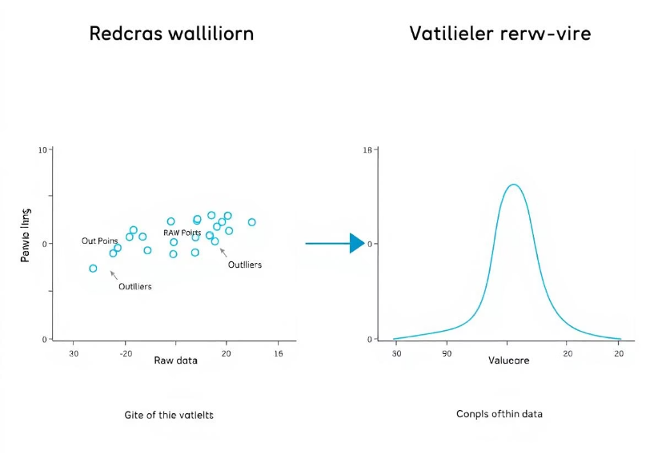
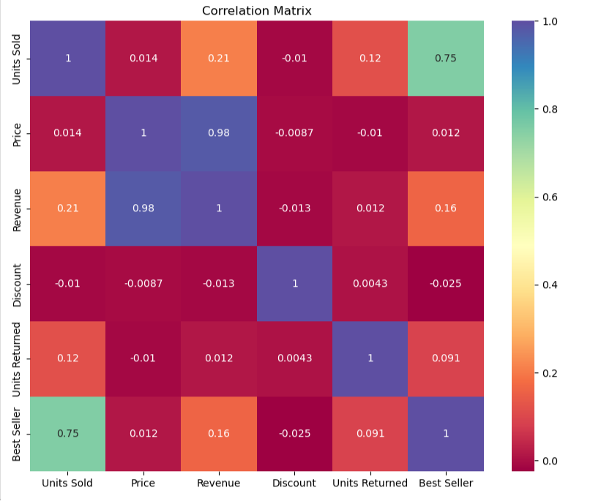
Visual Insights & Interpretations
Boxplots were instrumental in visualizing the distribution of numerical features both before and after outlier removal. This comparison clearly demonstrated the impact of our preprocessing steps on data clarity and consistency, ensuring cleaner input for the model.
Correlation matrix provided a concise visual summary of the relationships between different features. They helped us identify the most influential factors impacting a supplement's best-seller status, guiding feature selection and model interpretation. Furthermore, countplots offered insights into category distribution, confirming balance.

Slide 8
Conclusion
Successful Classification
We successfully developed and validated a Logistic Regression model capable of classifying best-seller supplements with high accuracy, demonstrating the effectiveness of our preprocessing and modeling pipeline.
Improved Accuracy through Preprocessing
The meticulous preprocessing steps, including handling missing values, removing duplicates, and outlier detection, were critical in significantly enhancing the model's predictive performance and overall accuracy.
Ensemble Methods Exploration
Future work will focus on exploring more advanced ensemble methods such as Random Forest and Gradient Boosting. These models often provide increased robustness and predictive power by combining multiple weaker learners.
Real-Time Model Deployment
The next step involves deploying the classification model within a product analytics pipeline. This will enable real-time predictions, providing immediate insights for product management and marketing teams.
Sentiment Analysis Integration
To enrich the predictive capabilities, we plan to incorporate customer sentiment analysis from reviews and social media. This qualitative data will provide a deeper understanding of customer preferences, leading to more nuanced and accurate best-seller predictions.

